Slide 1
CGB1201 – JAVA PROGRAMMING PROJECT REVIEW-2
Department of Artificial Intelligence and Data Science
Academic Year: 2024 – 2025 (Odd Semester)
Register Number : 2303811724321071
Name : Mukesh M
Year : II Year
Semester : III
Section : B
Date : 25-11-2024

Slide 2
Online Job Portal

Slide 3
Problem Identification
Difficulty for job seekers to find jobs that match their skills and preferences.
Employers face challenges in posting job openings and reviewing suitable candidates quickly and efficiently.
Lack of a centralized system that can provide a user-friendly experience for both parties in the hiring process .

Slide 4
Objective
Job seekers to:
Register, create profiles, and search for job openings.
Apply for jobs matching their skills and preferences.
Employers to:
Register, log in, and post job openings.
Search and review applications from job seekers.
The system will provide essential functions for:
Managing profiles for both job seekers and employers.
Matching jobs based on keywords and job seeker profiles.

Slide 5
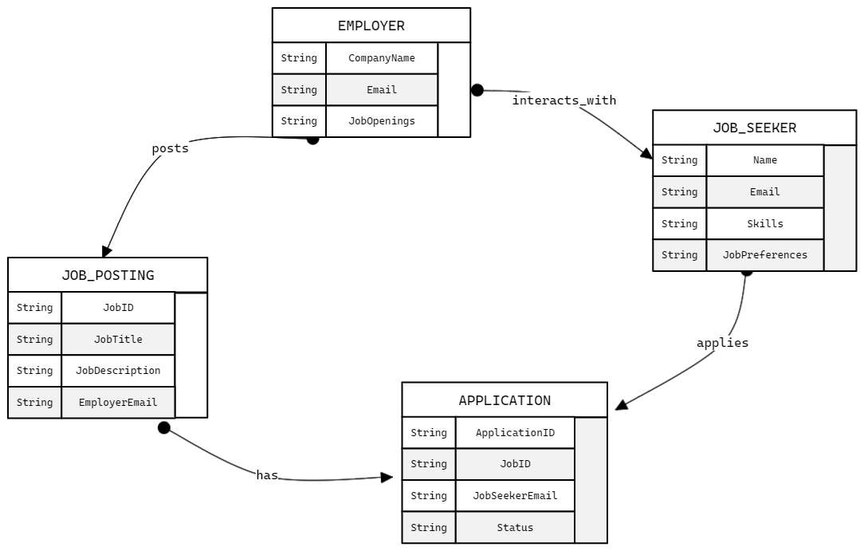
Proposed Architecture

Slide 6
Java Programming - Concepts Used
Classes and Objects: For users and system functions.
Encapsulation: Secure user data management.
(Hashmap) – For storing users data.
(ArrayList) - For dynamic job postings and preferences.
Control Structures: For navigation and workflows.
Scanner Class: To handle user input seamlessly.

Slide 7
List of Modules
Job Seeker Module:
Registration
Login
Research jobs
Profile Management
Employee Module:
Registration
Login
Post job openings
View Applications (Place Holder)

Slide 8
List of Modules
System Module:
Main menu navigation
Data storage and retrieval via collections

Slide 9
Module Description
Job Seeker Module
Registration: Create an account with personal details, skills, and job preferences.
Login: Secure access using email and password.
Search Jobs: Search relevant jobs using keywords.
Profile Management: View and update skills and preferences.

Slide 10
Module Description (Cont..)
Employer Module
Registration: Register with company details, email, and password.
Login: Secure access to manage job postings.
Post Job Openings: Add new job postings with specific details.
View Applications: Placeholder for managing job applications.

Slide 11
Module Description (Cont..)
System Module
Main Menu Navigation: Menu-driven interface for user options.
Data Storage: Efficiently stores and retrieves user data using Java collections.
Integration: Links seeker and employer modules for seamless functionality.

Slide 12
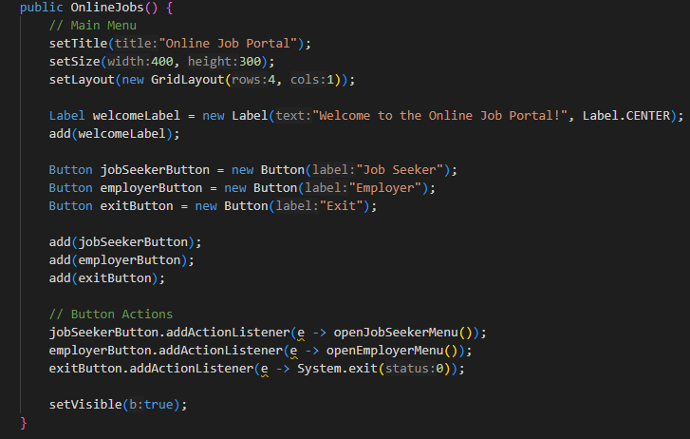
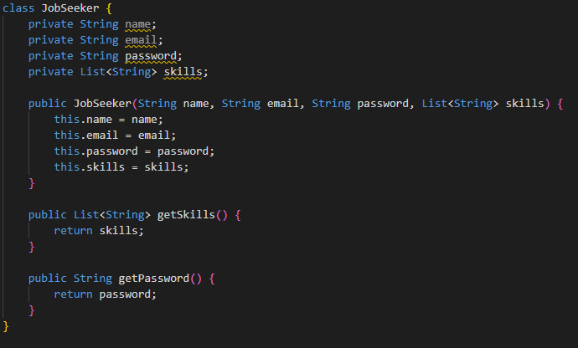
Source Code

Slide 13
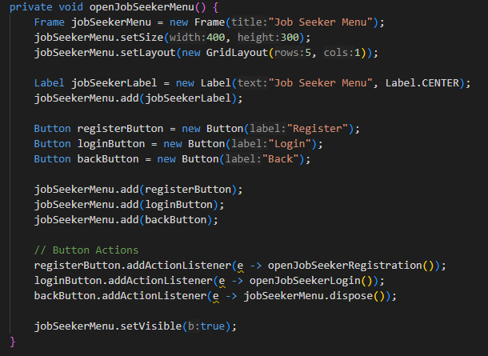
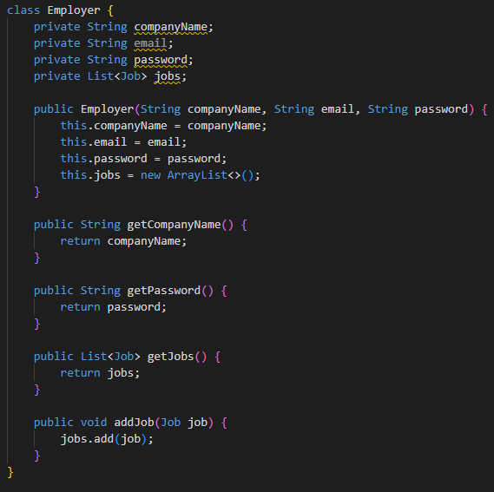
Source Code

Slide 14
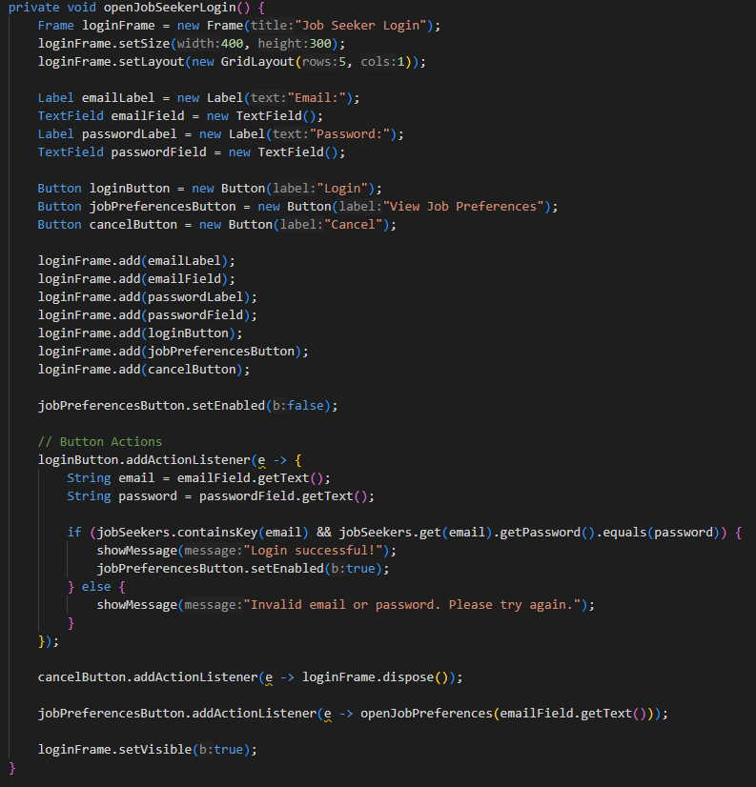
Source Code

Slide 15
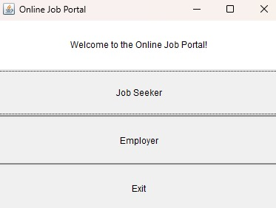
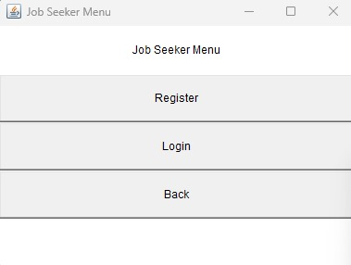
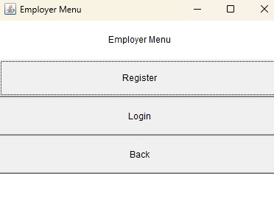
Results

Slide 16
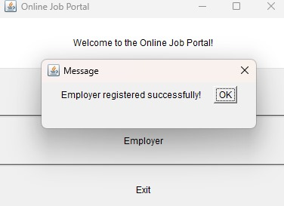
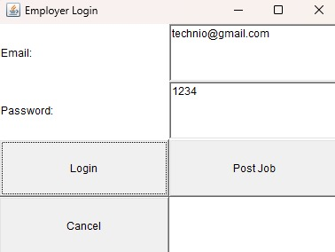
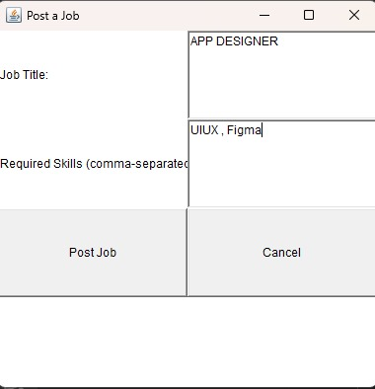
Results

Slide 17
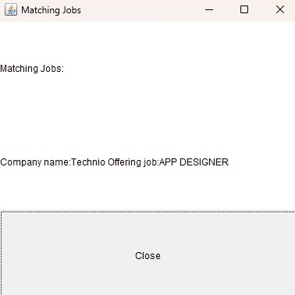
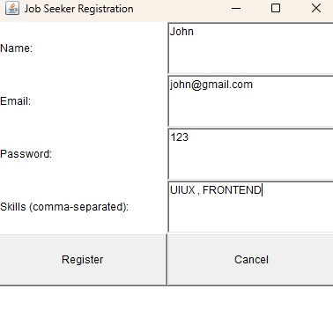
Results

Slide 18
Conclusion
The Online Job Portal demonstrates the application of Java’s core features to build a real-world system. Its scalable design can be extended with a graphical user interface and database connectivity for better usability.

Slide 19
Thank You
Any queries???

